Slide 1
Phase 1 Progress Review Discussion Template
GSA, Office of Shared Solutions and Performance Improvement
Month, Year

Slide 2
Questions to be Answered
This template is intended to guide a Progress Review discussion between a Customer, Provider and Key Stakeholders.
Questions to Be Answered
 | Does the scope and operational end state make sense? Does the agency’s business plan align with federal strategy and target outcomes?
 | Is there a valid need for the investment?
 | Were alternatives considered (if shared services is not the strategy)? Does the organization understand the trade off between benefits and risks associated with the modernization or migration?
 | How reasonable is the preliminary total migration cost? What language should be included in pass-back?
 | Does the investment incorporate new or existing policy? Is it a result of new or existing policy?
0. Assessment
 | Does the effort align with each office initiative?
 | Has the Life Cycle Cost Estimate (LCCE) been updated to reflect business capabilities, and is it reasonable?
 | Do the high-level capabilities identified by the agency meet the standard capabilities identified by the Service Area Managing Partner? Are any additional capabilities justified by mission needs or regulation?
 | How inclusive is the risk analysis? Is the program adequately resourced (funding and people) to support due diligence and engagement with a provider? Does the program have adequate plans to mitigate critical issues and risks and contingency plans? Has the customer demonstrated robust planning in order to conduct due-diligence with providers? Does the organization have an general understanding of what the benefits of the program would be?
1. Readiness

Slide 3
Instructions for Completing This Template
This template is intended to guide a Progress Review discussion between a Customer, Provider and Key Stakeholders.
To use this template:
Use the source documents included within each slide to develop summary-level information that will help guide the Progress Review
Be prepared to discuss specific questions/content included on each slide before or during the Progress Review
Once complete, schedule a Progress Review meeting

Slide 4
Documentation Required for Phase 1 Progress Review
The following documentation is required in guiding a discussion to demonstrate readiness and gain approval for Phase 1. Agencies purchasing transaction processing services only will identify relevant activities and artifacts for their project using the M3 Services Tailoring Guide.
Phase 1 Documentation
Acquisition Strategy As-Is Systems Environment As-Is Workforce Documentation Baseline and Target Performance and Success Metrics Business Capabilities Business Needs Workbook Business Readiness Assessment Change Management Plan Change Readiness Assessment Communications Plan Data Cleansing Plan Data Governance Model Governance Plan Independent Verification & Validation (IV&V) Plan Initial Master Schedule Investment Readiness Checklist | Life Cycle Cost Estimate (LCCE) M3 Risk Assessment Tool Migration and O&M training needs Program Charter Program Management Plan Project Business Case Quality Assurance Surveillance Plan (QASP) Requirements Management Plan Resource Management Plan Risk Management Plan Risks, Actions, Issues, and Decisions (RAID) Log Stakeholder Analysis Status Reports/Dashboard Target State Concept of Operations Target State Systems Environment Workforce Assessment
Information Contained in Progress Review Discussion
Acquisition Strategy Baseline and Target Performance Success Metrics Defined Business Capabilities Business Readiness Assessment Change Management and Communications Approach Data Management/Data Quality Approach Initial Master Schedule Overview Investment Readiness Checklist IV&V Plan LCCE Market Research M3 Risk Assessment Tool Program Governance Model Project Business Case Resource Management Plan Scope of Services Overview Top Risks
Exit Criteria (to move into Phase 2)
Acquisition Strategy Baseline and Target Performance Success Metrics Defined; Aligned with Performance Framework Change Management Strategies Defined Completed Business Readiness Assessment Completed Project Business Case Confirmed Alignment of Business Capabilities against FIBF Data Quality Assessed | Initial Master Schedule Defined Initial QSMO Marketplace Research Conducted Investment Readiness Checklist LCCE Developed Mitigation Plans in Place for Major Risks/Issues PMO and Governance Structure Defined Resources on-boarded Risks and Issues Management Defined

Slide 5
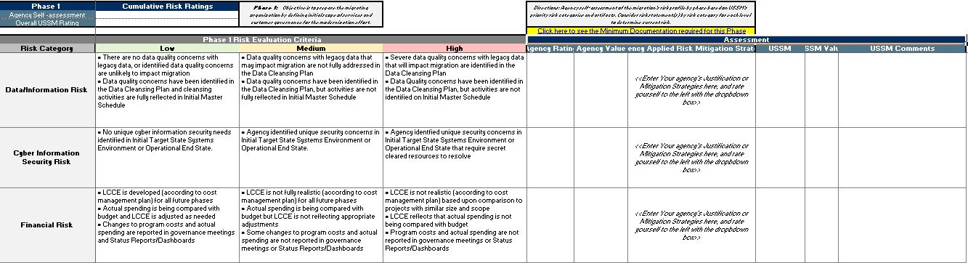

M3 Risk Assessment Tool
Determine the risk rating at the end of Phase 1 using the M3 Risk Assessment Tool and submit with Progress Review material.

Slide 6
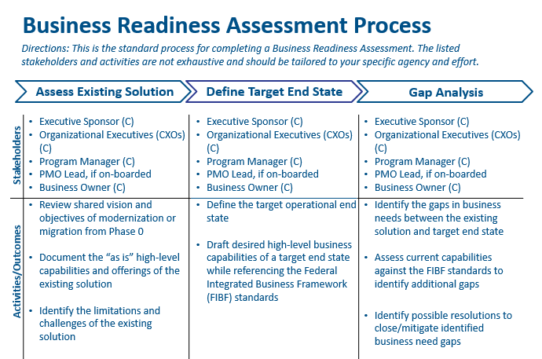
Business Readiness Assessment
Provide an overview of the Business Readiness Assessment performed at the beginning of Phase 1.
Provide a summary of the Business Readiness Assessment, which should include outcomes from:
Assessing the Existing Solution
Defining the Target End State
Gap Analysis
Source Documentation from Playbook
Business Readiness Assessment Template

Slide 7
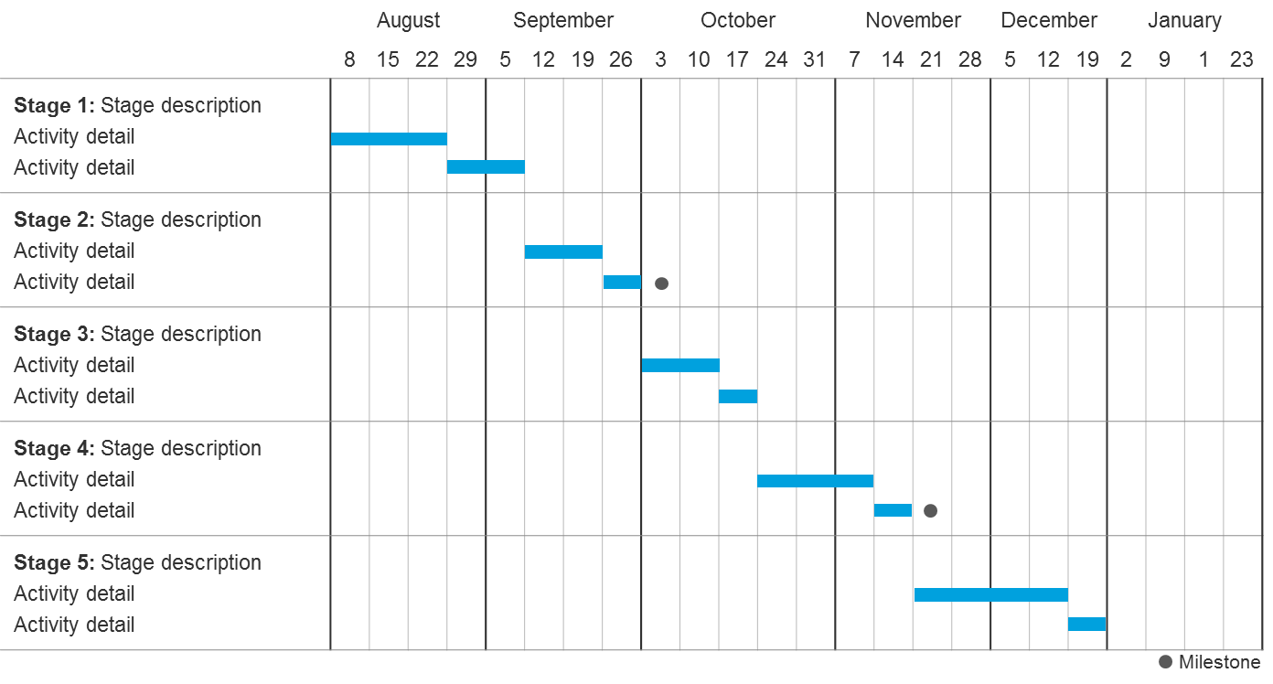
Initial Master Schedule Overview
Provide an overview of the Initial Master Schedule as of Phase 1
Provide a summary of the Master Schedule timeline, which should include:
Major activities and critical path milestones over the lifecycle of the program
Expected Progress timeline
Schedule constraints (e.g., contract end dates, system retirements)
Whether activities and milestones are on- or off-track
**Provide information by month and year
ILLUSTRATIVE
Source Documentation from Playbook
Initial Master Schedule

Slide 8
Life Cycle Cost Estimate (LCCE)
Provide the estimated cost based on the LCCE*.
Develop the life cycle cost information for Phase 1 based on any changes or refinement in scope of the program from when the Project Business Case was developed
Estimated Costs for Migration and Operations and Maintenance (O&M)
Responsible Party (Provider, Agency, Other) | Migration Cost Category / Work stream | FY N CPM | FY N+1 CPM | FY N+2 CPM | FY N+3 CPM | Total CPM | Cost Calculation | Required FTEs | Notes/Assumptions
 | Program Management Support
 | Data Conversion Support
 | Change Mgmt./Train
 | Business Process Reengineering
 | Systems Engineering
 | <Project or Organization Determined>
 | Total Migration
Provider | <Service Layer 1>
Provider | <Service Layer 2>
Agency | <Agency Cost>
 | Total O&M
Grand Total
ILLUSTRATIVE
*To avoid duplication of effort, agencies are encouraged to use their existing budgetary documentation, when available, to provide cost estimates.
Source Documentation from Playbook
LCCE

Slide 9
Resource Management Plan Overview
Provide an Organization Chart and indicate required number of full time equivalents (FTEs)/resources, existing resource gaps, and plan to fill resource gaps
Include the following:
The roles and responsibilities needed for the customer migration team in Phase 2
Total number of resources needed and total number of resources staffed
The percentage of time required for each position on the customer migration team
Vacant positions and plan to fill each position
For each role, indicate if resources are in an acting, detailed, or contractor-filled position
Source Documentation from Playbook
Resource Management Plan

Slide 10
Market Research & Acquisition Strategy
Provide the details around market research and planned procurements to support the migration
Potential data points could include:
An overview of the approach to conducting market research to select a provider, including how QSMOs, Requests for Information (RFIs) and Provider Agreements will be used to further market research efforts and ultimately select a provider
Potential additional support needed based on resourcing plan, legacy system support needs, data cleansing, and Independent Verification and Validation (IV&V)
Planned Procurement (including Scope) | Acquisition Strategy | Status* | Planned Contract Value | Expected Award Date | Expected Period of Performance
Data Conversion: Provide services to extract and translate data from legacy application…
ILLUSTRATIVE
*Statuses may include: Early Planning, Requirements Defined, Request for Proposal (RFP) Released, Award Complete
Source Documentation from Playbook
Acquisition Strategy

Slide 11
Independent Verification and Validation Plan
Describe the program’s approach for onboarding and utilizing IV&V support
Provide an overview of:
Timeline to obtain IV&V support
The scope IV&V activities that will occur during the program
The timing of IV&V activities during the program
The process to address IV&V feedback
IV&V relationships (i.e., who the sponsor is, and how IV&V support will interact with the provider, and OSSPI)
Source Documentation from Playbook
IV&V Plan

Slide 12
Program Governance Model
Describe the program’s governance model
Consider including the following:
The governance structure, which identifies the roles, responsibilities, and which offices are represented
The process, cadence, and timeline to make decisions
The process and criteria used to escalate decisions, issues, and risks
The scope of the governance (i.e., whether or not the program manager has the authority to approve changes that do not extend the schedule, the maximum dollar value of the costs, and increases or decreases to the scope)
Source Documentation from Playbook
Governance Plan

Slide 13
Scope of Services Overview
Describe which services the organization desires for migration and Operations and Maintenance (O&M)
Migration
O&M
Describe required migration services (e.g., training, data conversion, systems integration) from the provider
Describe required O&M services, including:
Desired service (e.g., Financial Management, HR, Acquisition)
Function (e.g., Payable Management)
Description of selected service layers (i.e., system platform, transaction processing, business application support)
Source Documentation from Playbook
Business Needs Workbook

Slide 14
Change Management and Communications Approach
Describe the stakeholders that will be impacted by the migration
Consider including information on the following:
The process for identifying impacted stakeholders
Analysis of stakeholder awareness by the community
Communications best practices that the stakeholder community will use
Source Documentation from Playbook
Communications Plan Change Management Strategy

Slide 15
Data Management/Data Quality Approach
Provide an overview of the data management and quality approach including an overview of findings from the initial data assessment
Consider including information on the following:
The results of your data quality assessment
Data cleansing activities that have already begun
The timeline for future data cleansing activities
Success criteria used to measure data quality
Source Documentation from Playbook
Data Governance Model Data Cleansing Plan

Slide 16
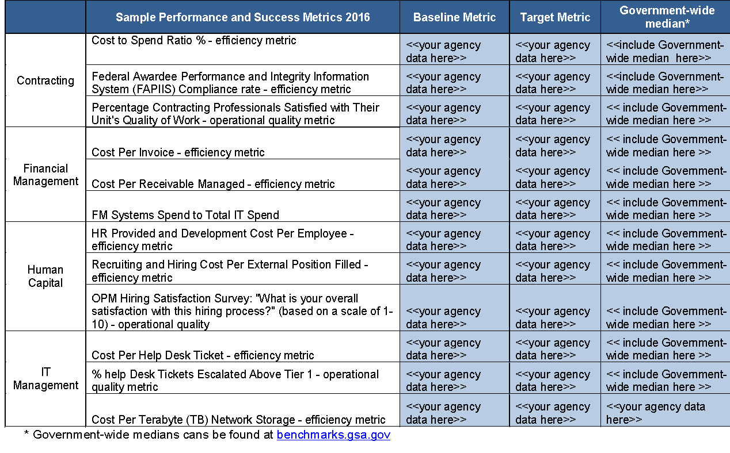
Baseline and Target Performance Success Metrics
Agencies may use existing federal-wide benchmarks available at https://benchmarks.gsa.gov/ or create their own. Below are sample Performance and Success metrics by service area.

Slide 17
Top Risks
Provide the top 5 – 10 risks identified during Phase 1 and proposed mitigation strategies
Risk | Impact | Probability | Owner | Mitigation Strategy
<Risk 1: If adequate resources are not dedicated to data cleansing, then cleansing activities will be delayed and the quality of the conversion will be reduced> | High | Medium | Program Manager | <Dedicate additional resources to support data cleansing efforts no later than 5/5> <Secure contractor support for data cleansing>
Source Documentation from Playbook
Risks, Actions, Issues, and Decisions (RAID) Log Risk Management Plan

Slide 18
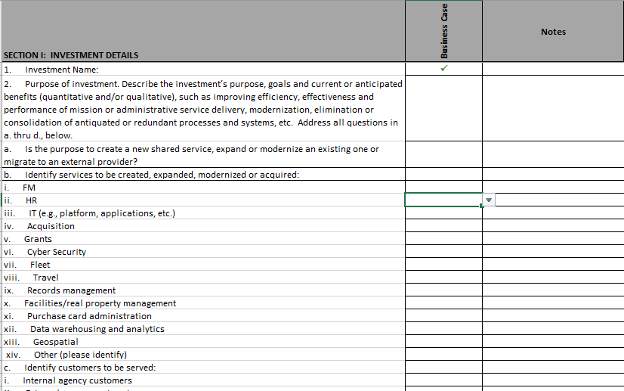
Project Business Case
Provide an overview of the Project Business Case developed throughout Phase 1.
Provide a summary of the Project Business Case, which should include outcomes from:
Outputs
Vision
Scope of services
Expected benefits
High-level timelines
Investment information
Risks
Activities and outcomes
Performance targets
Source Documentation from Playbook
Project Business Case Investment Readiness Checklist

Slide 19
Next Steps
Please describe the activities planned for the next 30, 60, and 90 days

